Slide 1

Multi Lingual Document Summarization
PRESENTED BY:
SHRUTHI BOBBA
VARSHA REDDY CHINTHALAPUDI
YASASWI NALLAMOTHU

Slide 2

CONTENTS
INTRODUCTION
SIGNIFICANCE
DATA GATHERING
DATA PROCESSING
LANGUAGE MODELS
NLP TOOLS AND TECHNIQUES
SUMMARIZATION

Slide 3

Introduction
In our digitally connected world, the "MultiLingual Document Summarization" project addresses the challenge of processing and summarizing vast multilingual text data. Leveraging advanced natural language processing techniques, this project aims to develop a tool that efficiently condenses extensive documents across various languages. It focuses on enhancing global communication and information accessibility, serving diverse sectors from academia to business. This endeavor contributes significantly to the evolving field of NLP, showcasing the potential for cross-lingual understanding and efficient information dissemination.​
​

Slide 4

Significance
Our project, "MultiLingual Document Summarization", is important because it helps people quickly understand lots of information from different languages. Imagine having a big book in a language you don't know – our tool can summarize it into a few easy sentences in your language. This is really helpful for everyone who needs to read and understand lots of information from around the world, like students, journalists, and businesses. It's like having a super-fast translator and reader in one!"​

Slide 5

DATA GATHERING
Different Texts: We picked a variety of texts, like stories from novels and articles found online, to make sure our tool learns from different kinds of writing.
English and Arabic: We gathered texts in both English and Arabic. This helps our tool understand and summarize things in both these languages.
Using Translators: For the Arabic texts, we used translation tools to make sure everything was accurate and understandable.
Quality: We made sure to choose texts that were interesting and important, so our tool learns to summarize really well.
Data Preparation: After collecting them, we cleaned up these texts and got them ready for our tool to learn from.

Slide 6

Data Processing​
Data Processing techniques used are:
Cleaning Text Data: Removing new lines, stop words and punctuations
Tokenizing input into sentences
Tokenizing sentences into words
Lemmatization
compute lemmas distribution
Part-of-Speech Tagging
Sentence Extraction and Processing

Slide 7

lid.176.ftz (A Language Detection Model)
In our project, the lid.176.ftz model from FastText plays a crucial role in identifying whether a document is in English or Arabic. This efficient model can detect 176 languages, making it highly effective for our needs. It ensures that each text is analyzed using the correct language model, enhancing the accuracy of our summarization process. This capability is not only vital for our current project but also paves the way for including more languages in the future, demonstrating the model's versatility and our project's scalability.

Slide 8
The Role of Language Models
Understanding Linguistic
Efficient Text Processing
Customized Processing for Each Language
Enhancing Summarization Accuracy
Scalability and Adaptability

Slide 9
English & Arabic Language Models: Pillars of Multilingual Processing
In our project, we use special tools called language models to understand and summarize texts in English and Arabic. The English language model is really good at figuring out English sentences, including the tricky parts like idioms. On the other hand, the Arabic model is great at handling Arabic text, which has its own special rules and is written differently. Both these models help us break down sentences into simpler parts, find the base form of words, and understand each word's role in a sentence. This way, we make sure our summaries are accurate and keep the original meaning of the texts, whether they're in English or Arabic. Together, these models are super important for making our project work well with two different languages.

Slide 10
Why Use a Language Model Beyond Basic Data Processing?
Deep Linguistic Understanding
Handling Complex Language Structures
Improved Accuracy in NLP Tasks
Contextual Relevance and Coherence
Scalability and Adaptability
Advanced Features
Enhancing Text Summarization

Slide 11
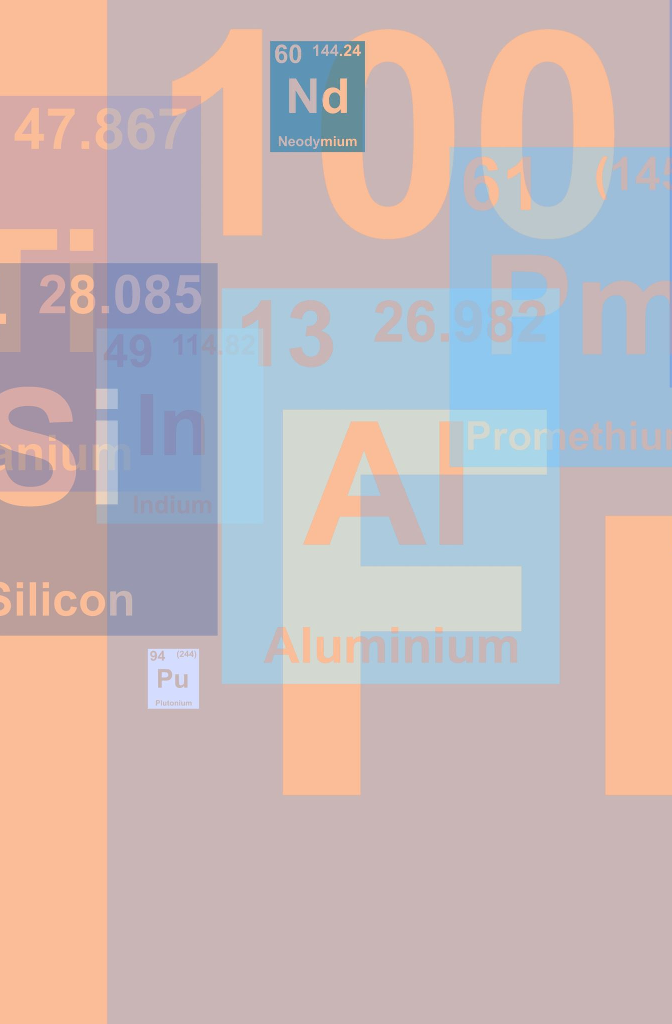
LDA (Latent Dirichlet Allocation)
LDA is a type of statistical model used for discovering abstract topics within a collection of documents.
It uncovers underlying themes by grouping words that frequently occur together across documents.
Widely used in text mining and natural language processing to organize and understand large sets of textual data.
LDA helps in extracting meaningful patterns and topics, making large volumes of text data more manageable and interpretable.
Assumes each document is a mixture of topics, and each topic is a mixture of words. This helps in categorizing texts based on their topic composition.

Slide 12

Utilizing LDA in Our Multilingual Summarization Project
LDA is employed to identify the main topics present in the multilingual documents we process.
By understanding the dominant topics in each document, LDA assists in generating summaries that accurately reflect the core content.
Tailored to handle the nuances of both English and Arabic texts, ensuring relevant topic extraction from documents in both languages.
Works in tandem with our English and Arabic language models to enrich the summarization process with topic-focused insights.
Leads to more informative, cohesive, and comprehensive summaries by focusing on the most pertinent topics within the documents.

Slide 13

SUMMARIZATION
Our objective is to condense large volumes of text into concise, informative summaries without losing the essence and key information. Our method is to adept at summarizing both English and Arabic texts, maintaining the integrity and meaning of each language. Utilizes English and Arabic language models for accurate linguistic analysis, ensuring that summaries capture the nuanced essence of each language. The final summaries are saved in a text file format. This method of documentation facilitates easy access and distribution, ensuring that our concise and informative summaries are readily available for reference and use.

Slide 14


